Slide 1


Presented by R.Sathish Kumar
Hiring Process Analytics

Slide 2

Project Description
The aim of this project is to analyze the hiring trends of a multinational company (MNC) using a dataset provided by the company. As the lead Data Analyst at a Prestigious Organization like Google,the task is to extract meaning insights from the data and provide a details report to the hiring departments . The dataset includes the details about people who registered for a particular post in a department of this company

Slide 3
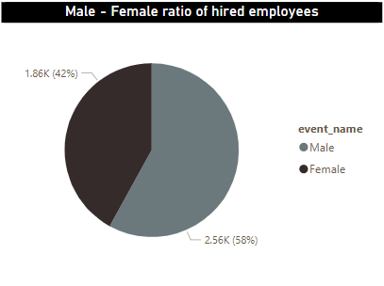
Task 1 : How Many Male and female have been hired by the company
Insight : The Company Hired more male (2563) Compared to Female (1856)

Slide 4

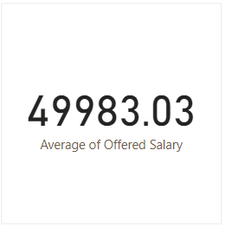
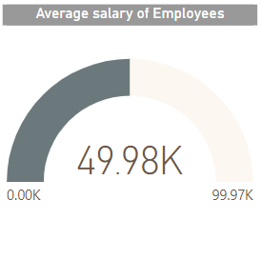

Task 2 : What is the average salary offered by this Company ?
Insight : The average salary offered in the company is INR:49983.03

Slide 5
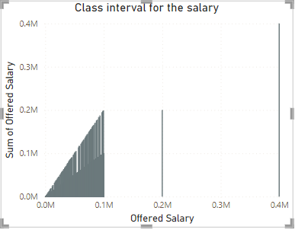
Task 3 : Class interval for the salaries in the company.

Slide 6
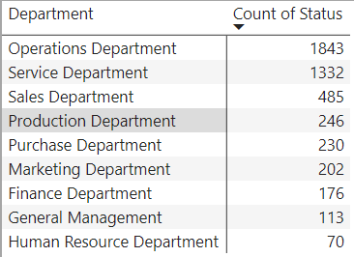
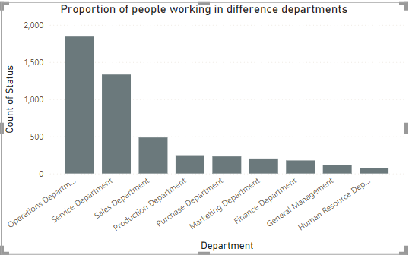
Task 4 : Any Graph to show proportion of people working different department .
The Majority of employees work in the “operation” and “service” departments

Slide 7
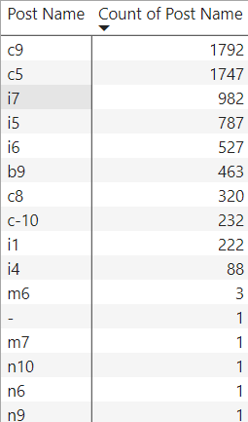
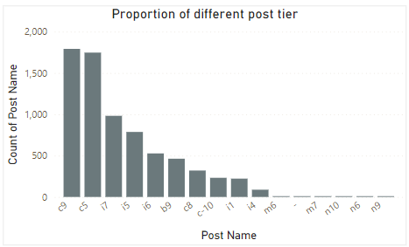
Task 5 : The Distribution of positions across different tiers.
The highest proportion of employees are in the “c9” post tier, followed “i7” and “c5”

Slide 8
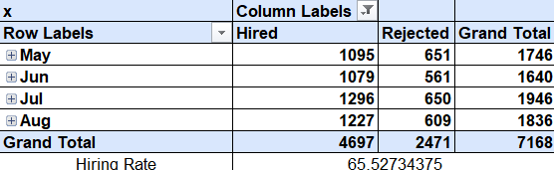
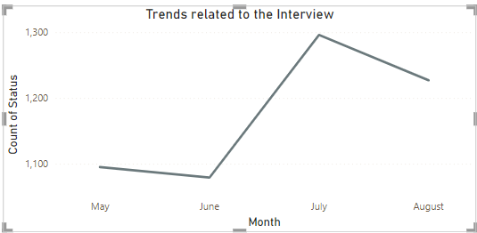
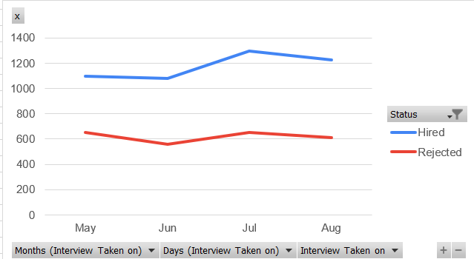
Task 6 : Identify any trends related to the date or time of the interview.
Hiring Rate ; 65.52%

Slide 9
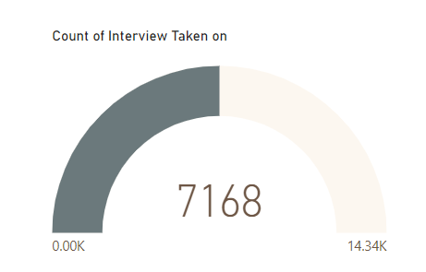
Task 7 : Metrics such as the average number of interview .

Slide 10
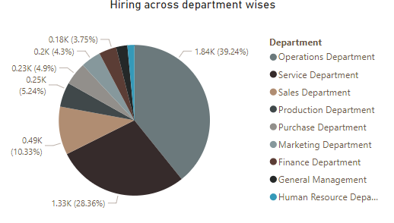
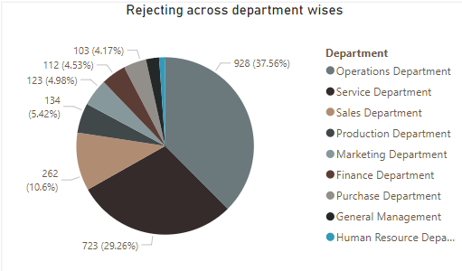
Task 8 : Department-wise Hiring trends the number of hired,rejected across different departments :

Slide 11

Presented by R.Sathish Kumar
Thank you very much!

